Slide 1
U.S. Department of Health and Human Services
Office on Women’s Health
National Health Indicators for Asian Women
The 2nd State of Asian Women’s Health in Massachusetts
Marian Mehegan, DDS, MPH
HHS OASH Region I Boston
May 21, 2014
The findings and conclusions in this presentation are those of the author and do not necessarily represent the views of the U.S. Department of Health and Human Services’ Office on Women’s Health.

Slide 2

An Introduction to the USDHHS Office on Women’s Health
One of twelve public health programs in the Office of the Assistant Secretary for Health (OASH)
Sex and Gender and racial/ethnic differences in women’s health
Website for education information and resources located at: www.womenshealth.gov or via the OWH Help Line @ 800-994-9662

Slide 3
Why Women?
Women are the gatekeepers to health information for their families!

Slide 4
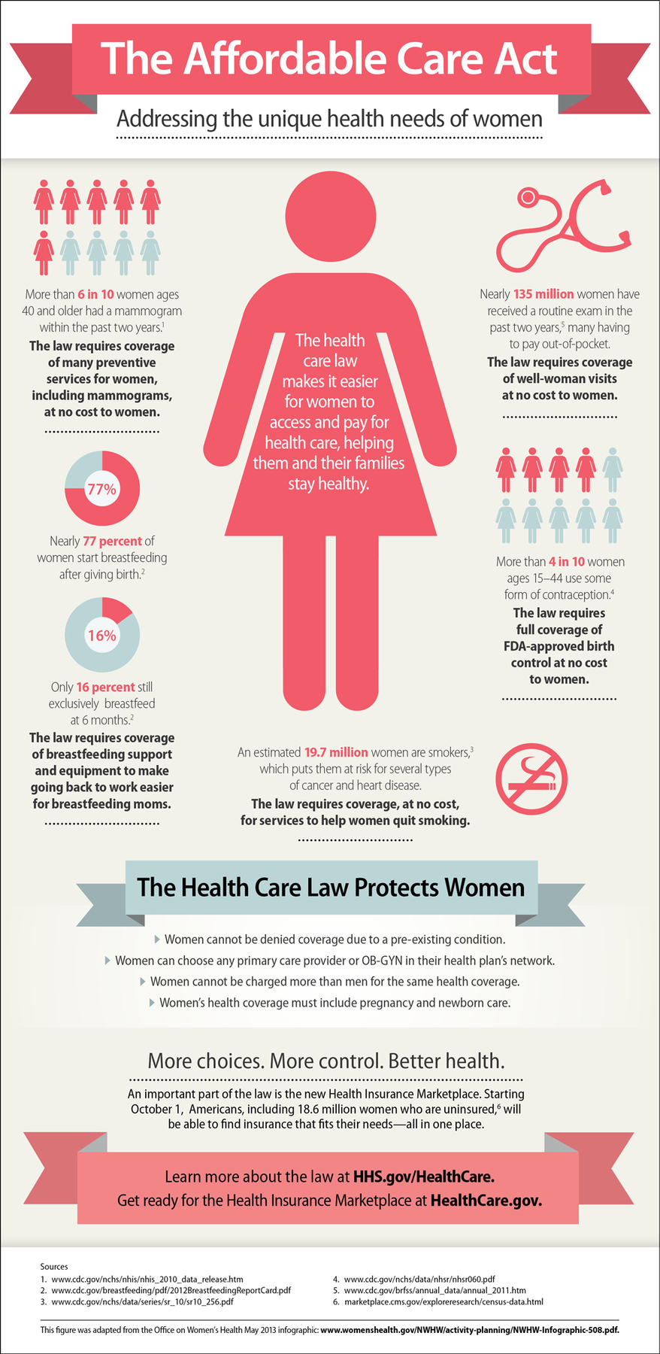
Women and the Affordable Care Act
Notes:
This infographic summarizes important key points about the ACA and women.
1. The health care law protects women, by addressing the unique health needs of women.
Allows women to have access to any primary care provider or OB/GYN in their network.
Health coverage must include pregnancy and newborn care.
Insurers can’t charge women more than men for the same health coverage.
Insurers can’t deny coverage do to a pre-existing condition.
The ACA More choices, more control, better health

Slide 5
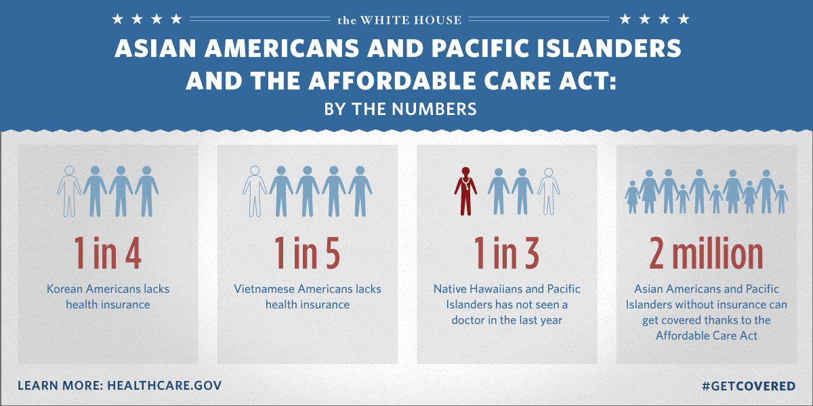
Notes:
Examples of the impact of the ACA on Asian Americans

Slide 6
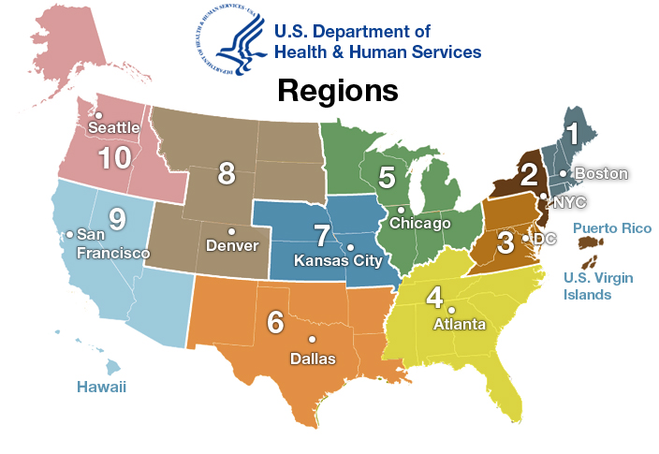
Women’s Health Programs in HHS Regional Offices

Slide 7

Quick Health Data Online (QHDO)
OWH resource developed by Quality Resource Systems (QRS, Inc.) in collaboration with OWH Regional Women’s Health Coordinators
Welcome to Quick Health Data Online webpage
Training sessions offered by QRS
Notes:
an interactive system that provides reliable and easily accessible health data to help assess needs, develop programs, and inform policies. The system is for anyone looking for US health data and is used by the public health community, policymakers, grant writers, researchers, and students.
provides state- and county-level data for all 50 states, the District of Columbia, and US territories and possessions. Data are available by gender, race and ethnicity and come from a variety of national and state sources. The system is organized into eleven main categories, including demographics, mortality, natality, reproductive health, violence, prevention, disease and mental health. Within each main category, there are numerous subcategories.

Slide 8

QHDO
Racial/Ethnic distribution of female residents for MA for the following fields:
Percent Total Females, Below Poverty and High School Graduation*
Health Conditions and Risk Factors
Notes:
2010 Census and NCHS; 2011 Census Bureau, American Community Survey
High school graduate estimate based on 25 years and older. Some estimates may reflect Asian data alone.

Slide 9
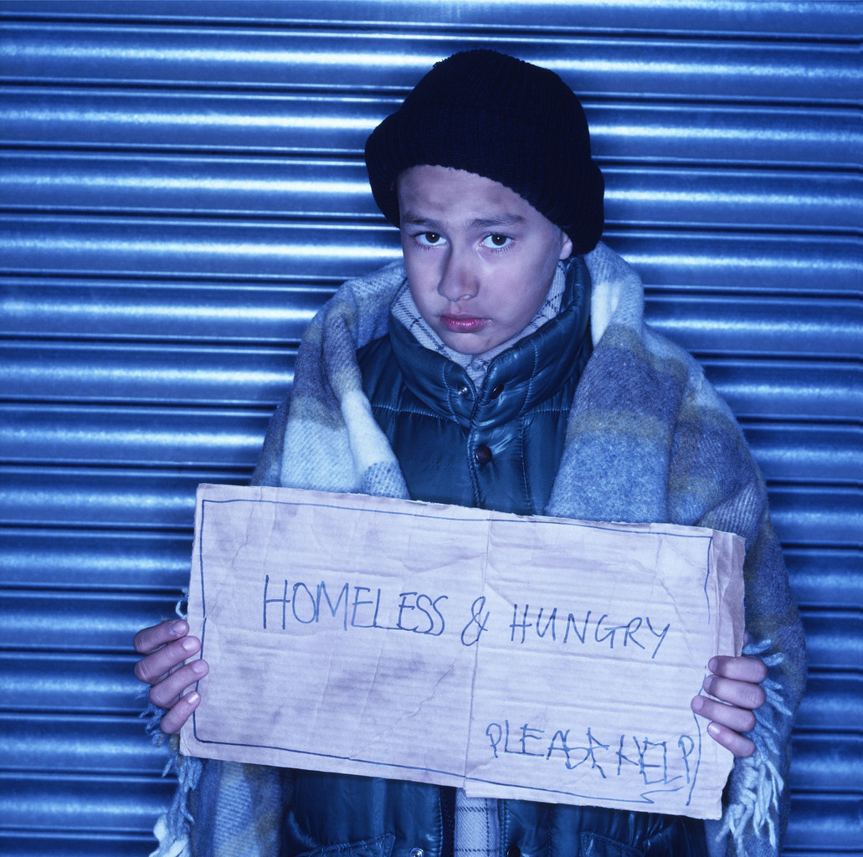
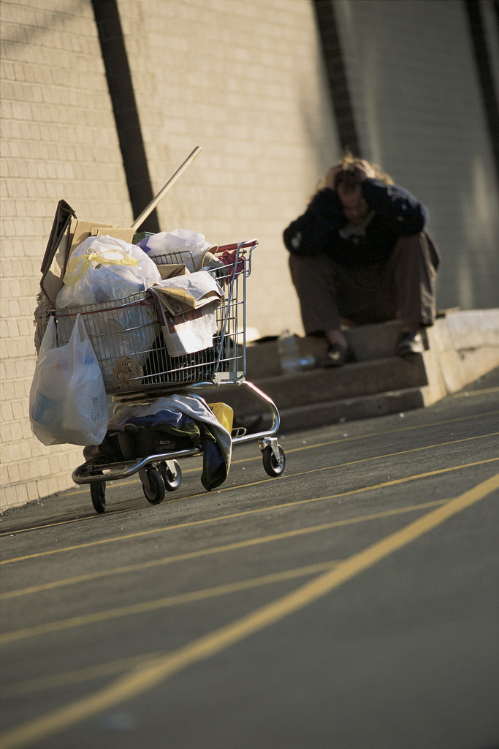
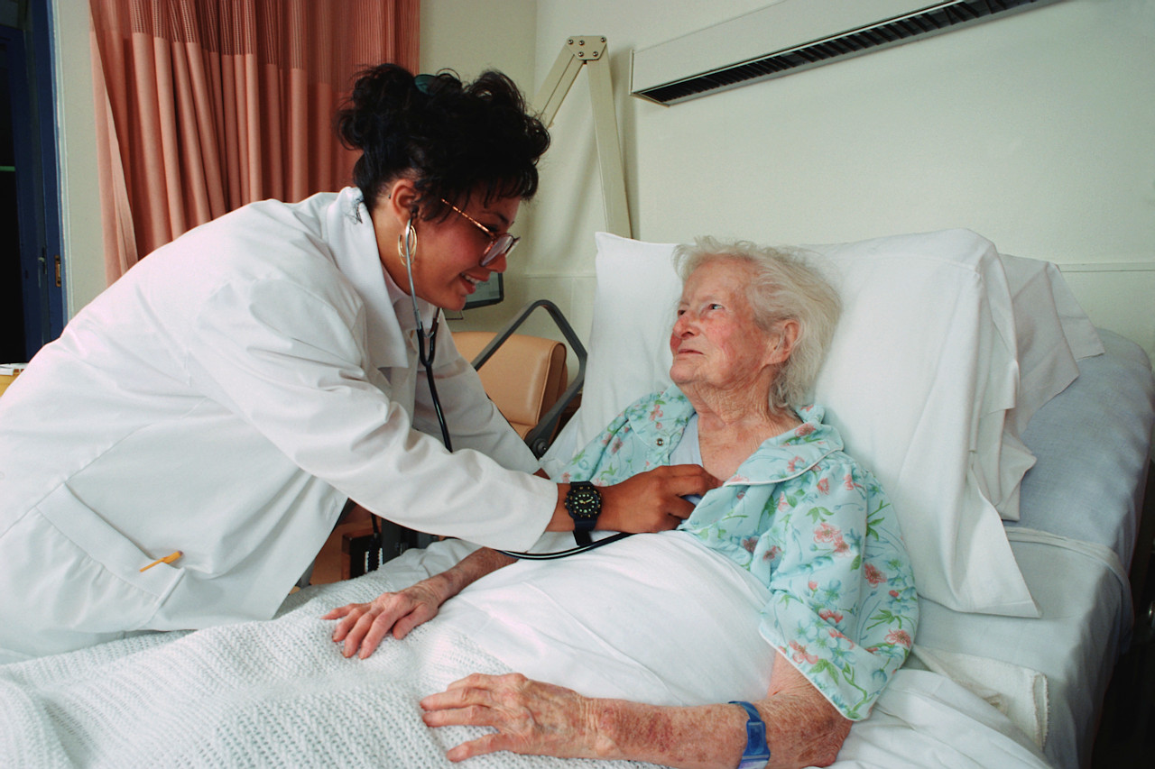
Factors Affecting Access and Literacy
Female Led Households with Children in Poverty
Percent Households Linguistically Isolated

Slide 10
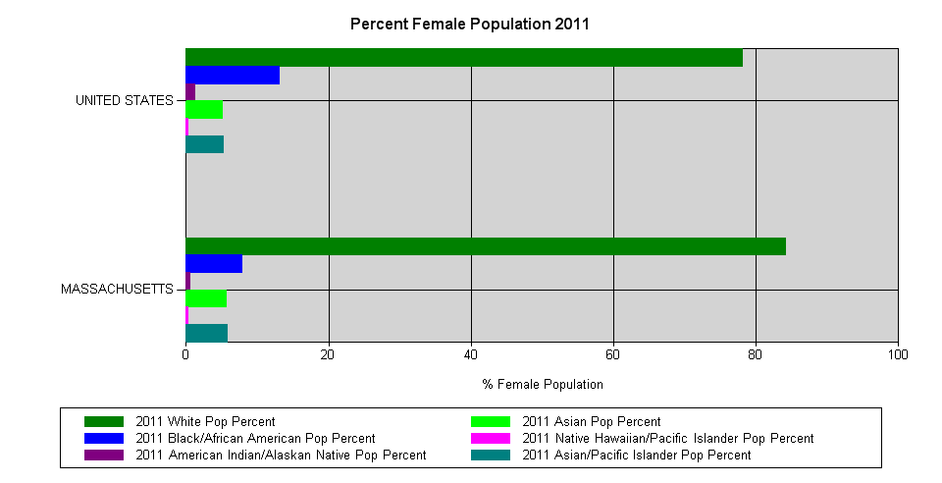
Percent Female Population 2011

Slide 11
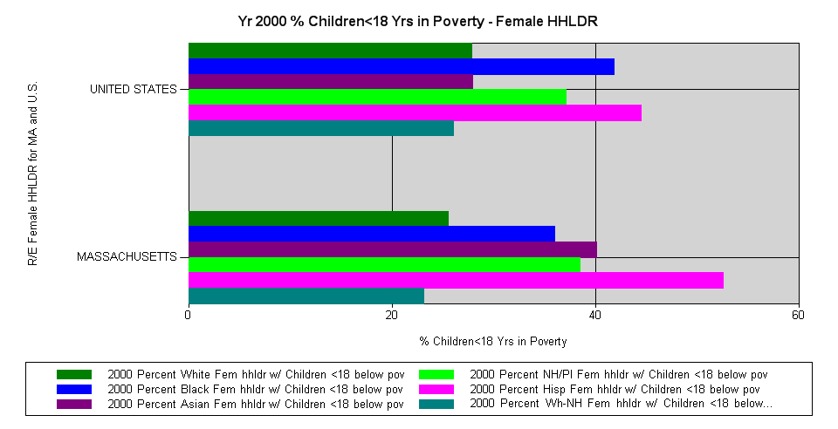
% Female Led Households, Children and Poverty 2000

Slide 12
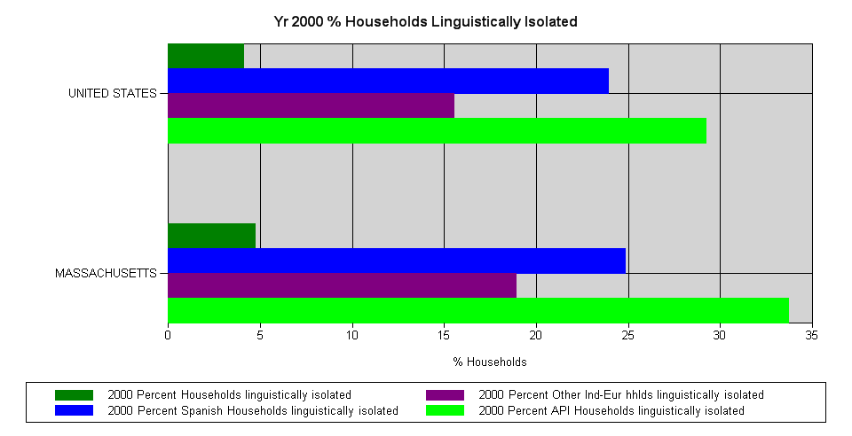
Percent Households Linguistically Isolated, 2000
Notes:
Census 2000, Asian Pacific Islanders were most liguistically isolated household of all races in U.S. and MA.
Classification based on all adults (age 14 or older) speak language other than English very well.
Data does not show population size or number of households by language.

Slide 13
What Does This Indicate?
Asian women are a small number of the population relative to other female racial groups.
As of last Census, Asian women were the largest racial group heading households below poverty and with children under 18 years.
In MA, more Asian women below poverty are heading households with children under age 18 relative to the U.S.
Although data not available for Asian women, with the 2000 Census, API households in MA were the largest number of linguistically isolated compared to other groups.

Slide 14
HLI Implications – Barriers to Access
Households that are linguistically isolated have less access to medical and social services.

Slide 15
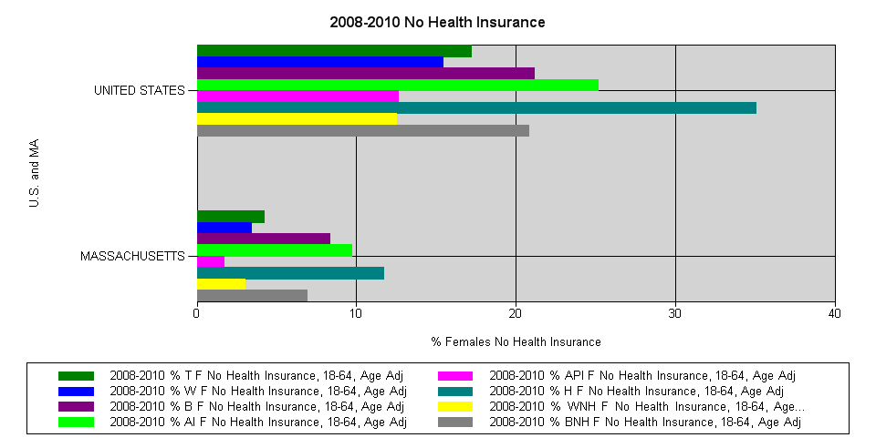
Reporting No Health Insurance, Ages 18-64
Age-Adjusted 2008-2010
Notes:
5 Year Average Estimated

Slide 16
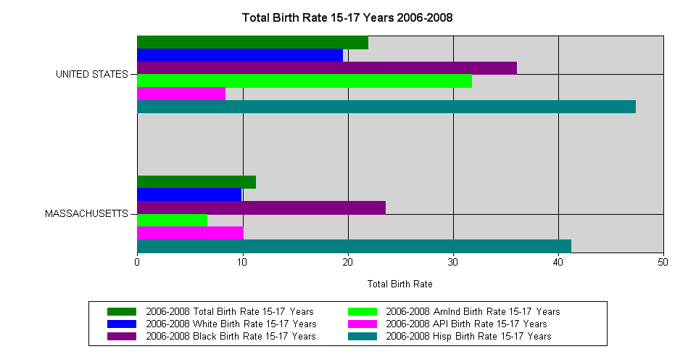
Total Birth Rate 15-17 Years 2006-2008*
Notes:
This slide notes Commonwealth’s API teen birth rate exceeds national API birth rate for 15-17 year olds.

Slide 17
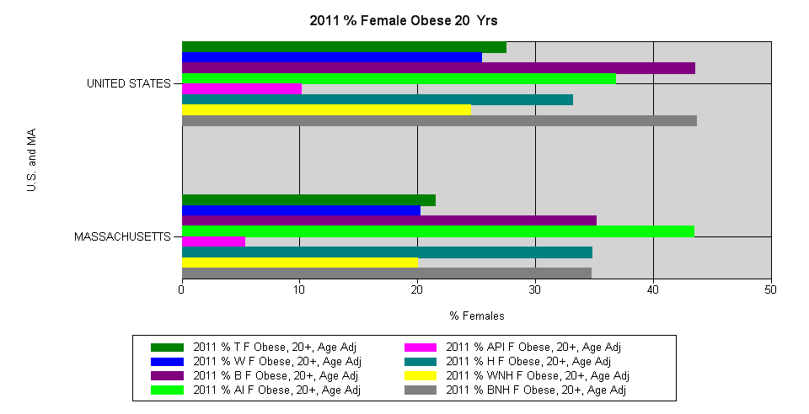
% Females 20+ Obese, Age-Adjusted 2011

Slide 18
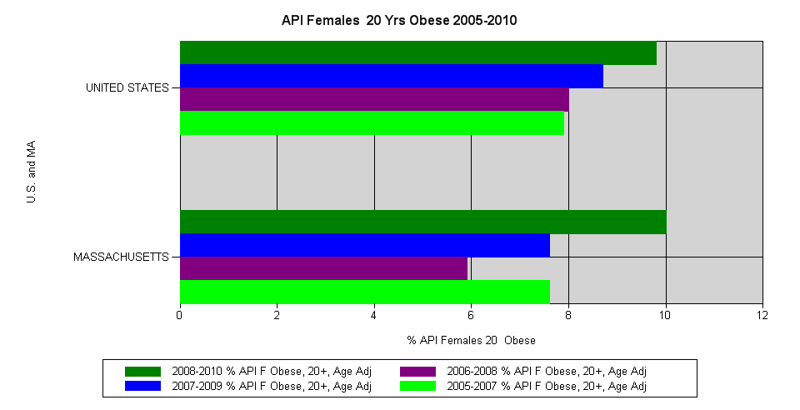
Percent API Females 20+ Obese, Age-Adjusted
2005-2010*

Slide 19
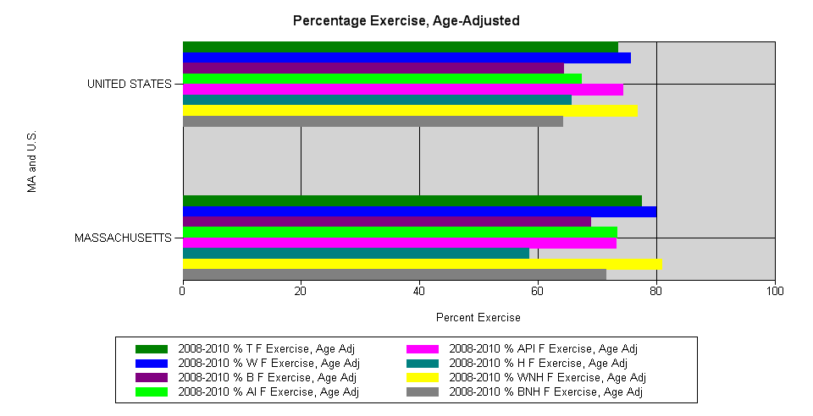
Percent Any Exercise Last 30 Days, Age-Adjusted
2008-2010

Slide 20
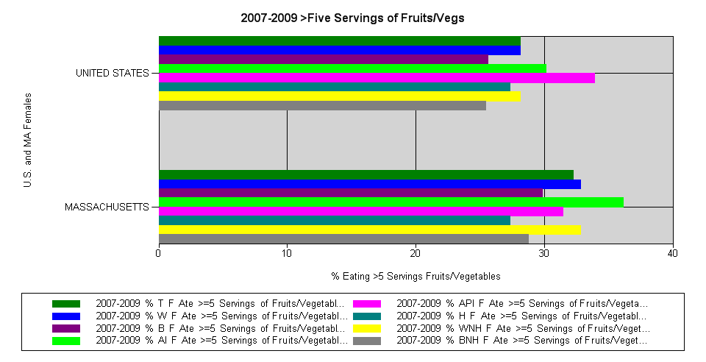
Eating Fruits and Vegetables, Age-Adjusted
2007-2009*
Notes:
Percent API population intake of five or more fruits and vegetables is higher nationally and higher than other races nationally.

Slide 21
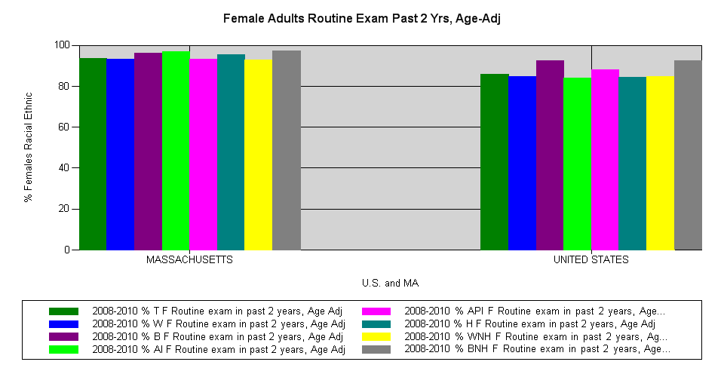
Routine Physical Exam Past 2 Years, Age-Adjusted 2008-2010

Slide 22
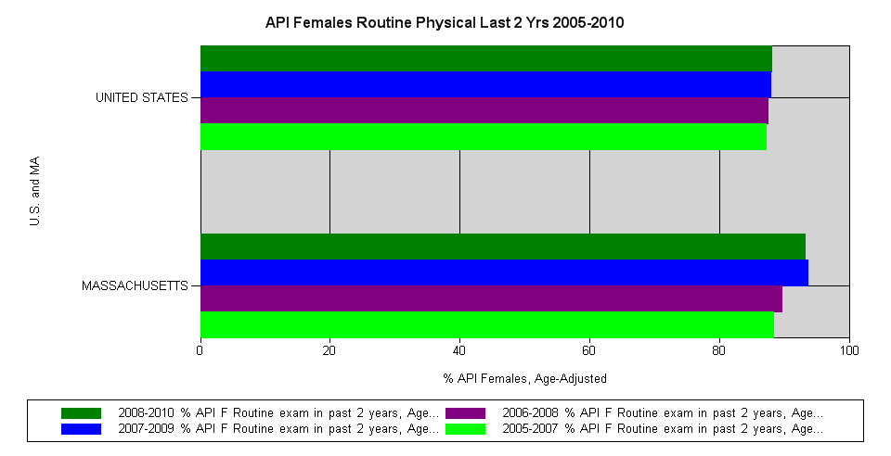
API Females Reporting Routine Physical Exam Last Two Years – Age-Adjusted 2005-2010

Slide 23
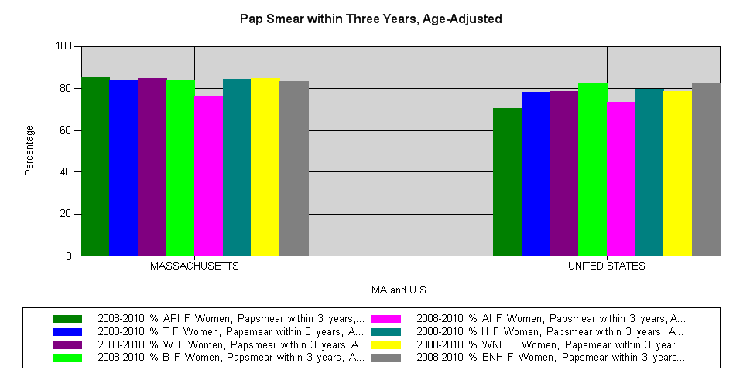
Pap Smear Within Three Years, Age-Adjusted 2008-2010

Slide 24
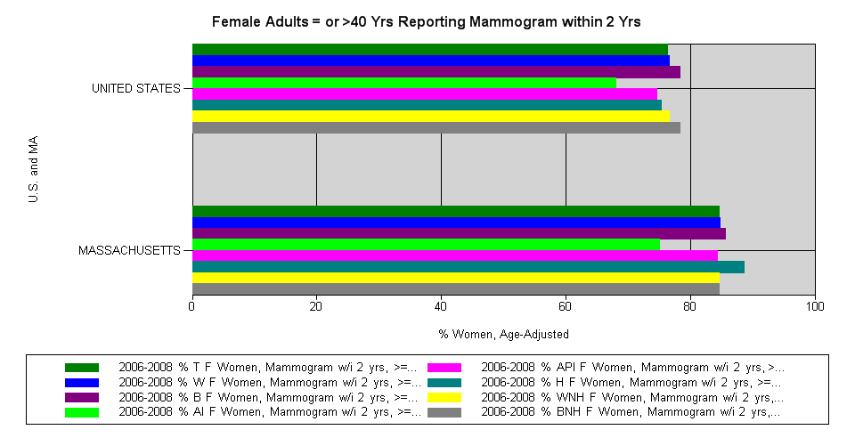
Adults =/> 40 Reporting Mammogram Last 2 Years, Age-Adjusted 2006-2008*
Notes:
“The model minority” API women trail AA and Hispanic women.

Slide 25
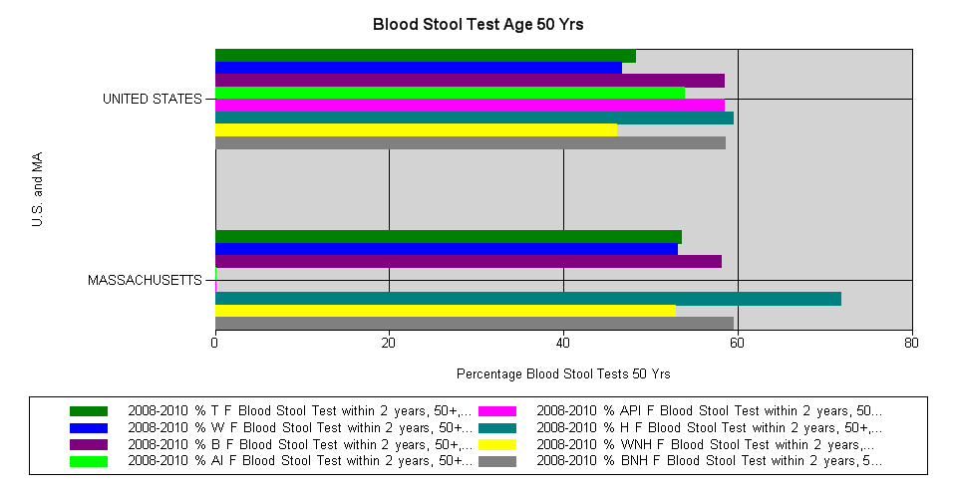
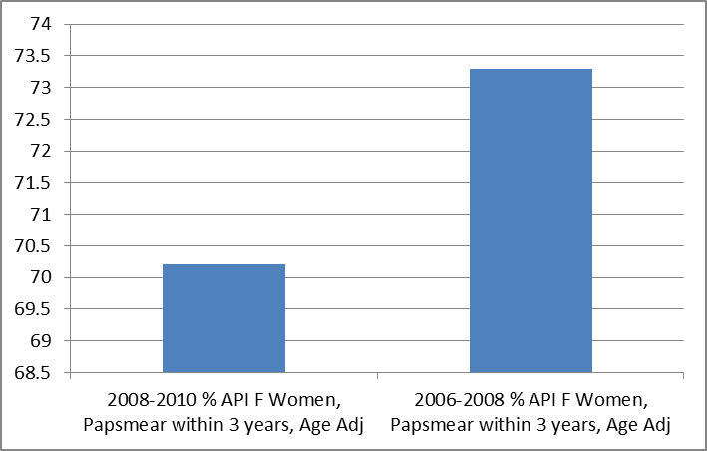
Blood Stool Tests 50 Years+, Age-Adjusted
2008-2010

Slide 26
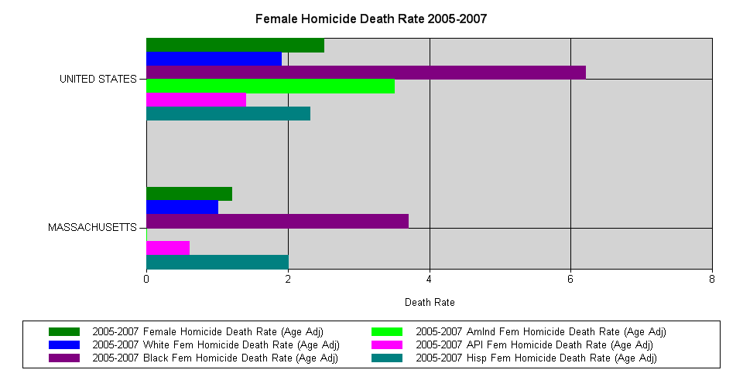
Female Homicide Rate, Age-Adjusted
2005-2007

Slide 27
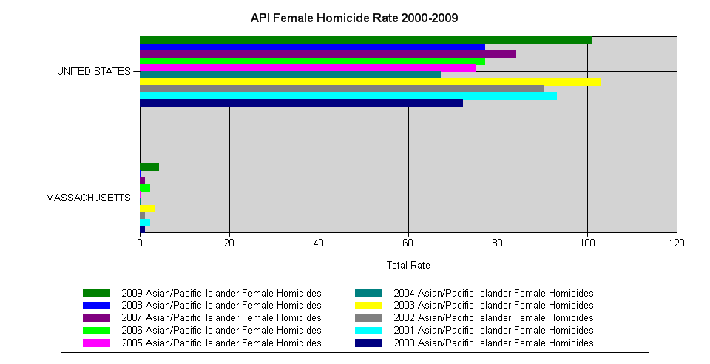
API Female Homicide Rate 2000-2009*
Notes:
Nationally, API death rates were increasing, except for 2003, the first peak. 2009 rate increase over 2008.

Slide 28
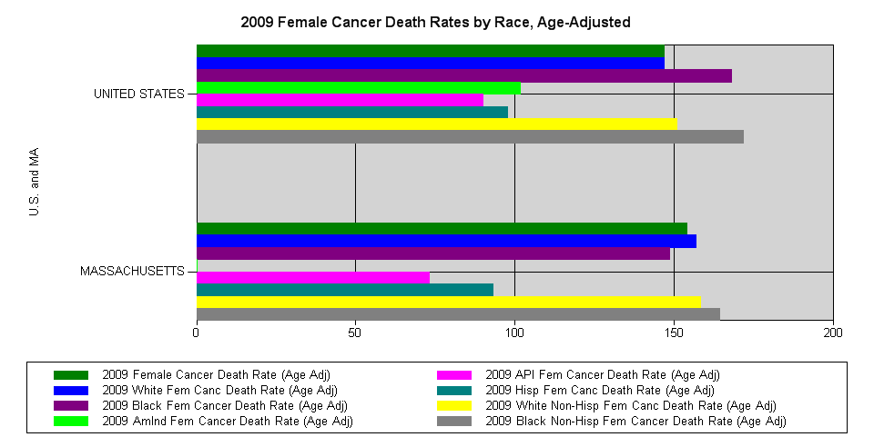
Female Cancer Death Rates, Age-Adjusted
2009

Slide 29
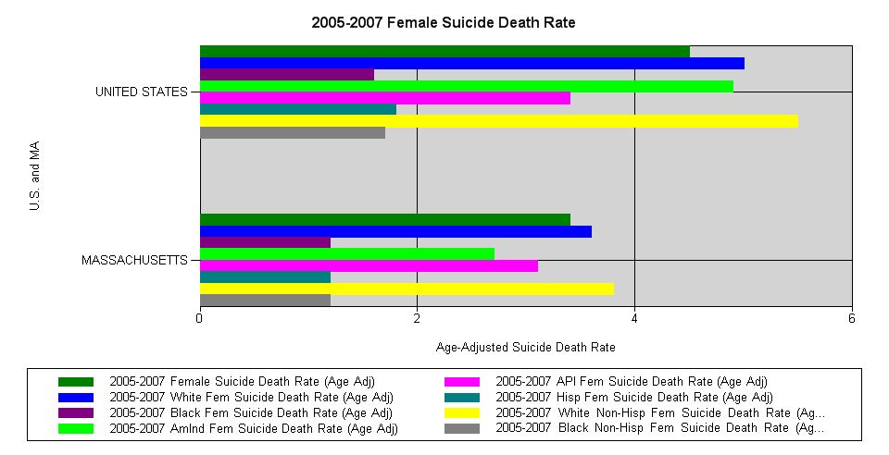
Suicide Death Rate, Age-Adjusted 2005-2007

Slide 30
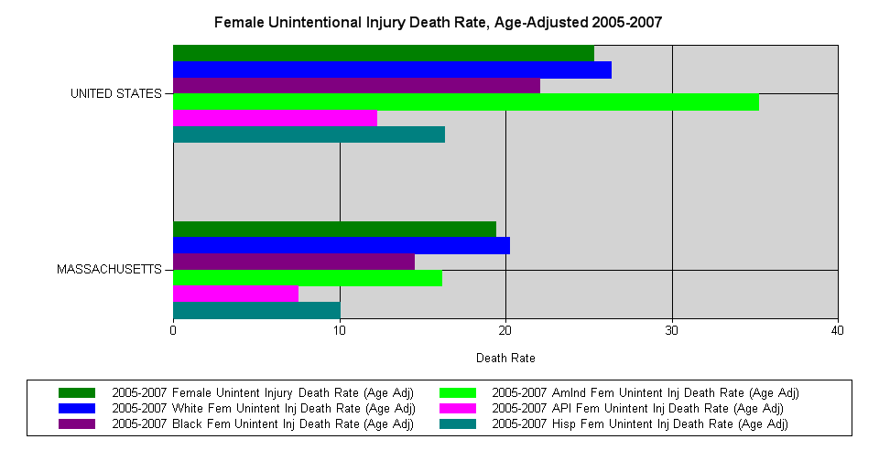
Unintentional Injury Death Rate 2005-2007

Slide 31
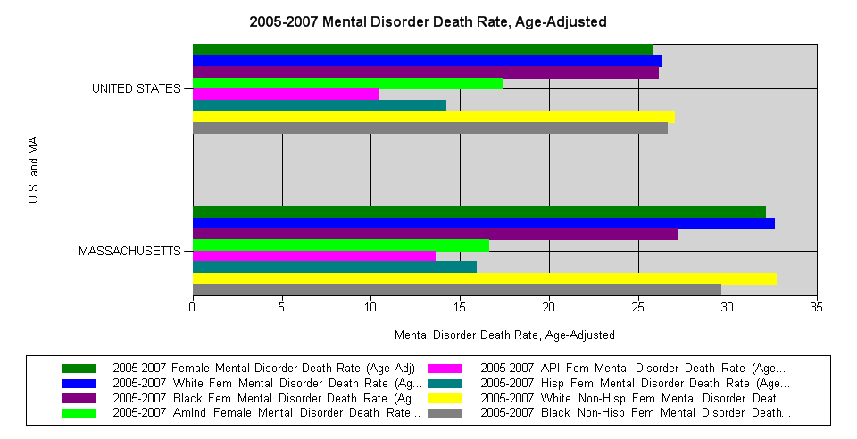
Mental Disorder Death Rate, Age-Adjusted
2005-2007

Slide 32
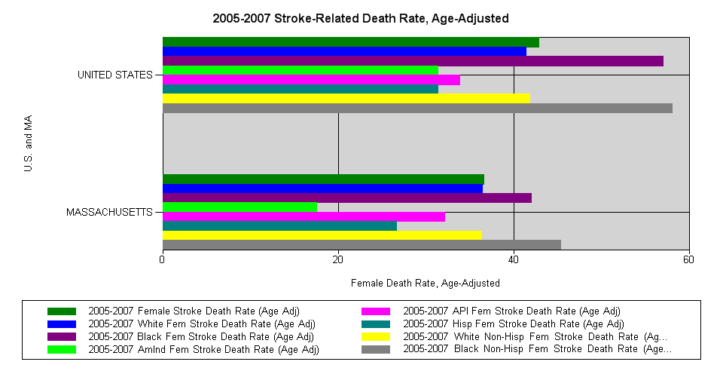
Stroke-Related Death Rate, Age-Adjusted
2005-2007

Slide 33
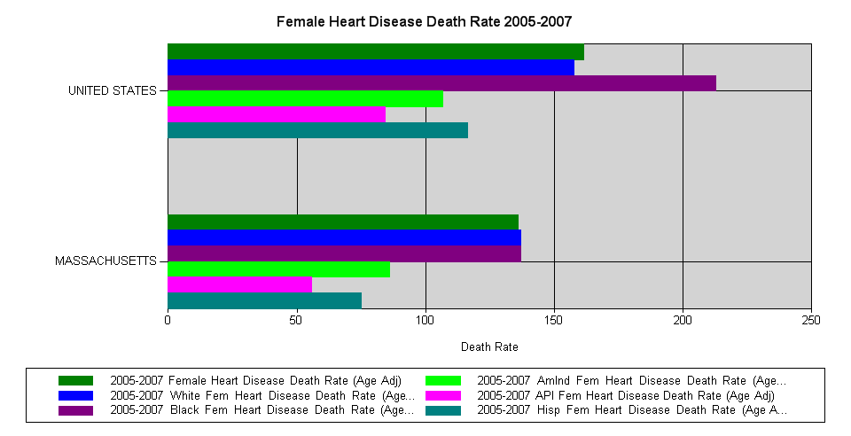
Heart Disease Death Rate, Age-Adjusted
2005-2007

Slide 34
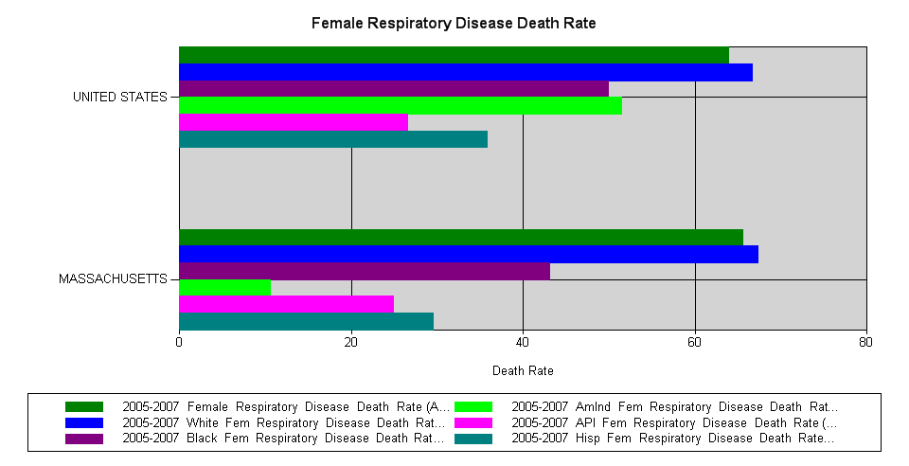
Respiratory Disease Death Rates
2005-2007

Slide 35
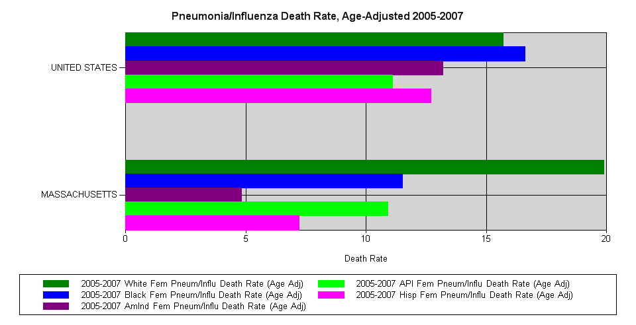
Pneumonia/Influenza Death Rate, Age-Adjusted
2005-2007

Slide 36
In Summary
Important to consider health indicators relative to size of population.
Look at health indicators over three year averages to allow for sufficient cell numbers.
Critical to look geographically closer at populations to discern small differences between populations.

Slide 37
Contact Information
Marian Mehegan, DDS, MPH
USDHHS Office on Women's Health
OASH Region I Boston
15 New Sudbury Street
Room 2126 JFK Building
Boston, MA 02203
Phone: 617-565-1071
Fax: 617-565-4265
Marian.Mehegan@hhs.gov

Slide 38
Thank you!

